Slide 1
Sampling Distribution (5 hours)

Slide 2
Introduction to Statistics
Statistics:
The word statistics has two meanings:
In the most common usage – statistics refers to numerical facts
The number that represents –
a) annual income of a family
b) age of a student
c) the percentage of students who scored grade A
d) the starting salary of a typical college graduate
What will be other examples of statistics? ……………..

Slide 3
The following examples present some statistics:
Approximately 30% of Google’s employees were female in July 2014 (USA TODAY, July 24, 2014).
In 2013, author James Patterson earned $90 million from the sale of his books (Forbes, September 29, 2014).
As per the CBS report, the hotel and restaurant, manufacturing and transportation sectors of Nepal will witness negative growth of 16.3 percent, 1.1 percent and 2.3 percent, respectively, in the current fiscal year (The Himalayan Times, April 30, 2020).

Slide 4
The second meaning of statistics refers to the field or discipline of study.
Statistics is the science of collecting, analyzing, presenting, and interpreting data, as well as of making decisions based on such analyses.
Every day we make decisions that may be personal, business related, experiment related or of some other kind.
Many times, the situations or problems we face in the real world have no precise or definite solution.

Slide 5
In such Statistical methods help us make scientific and intelligent decisions in such situations.
Decisions made by using statistical methods are called educated guesses
Decisions made without using statistical (or scientific) methods are called pure guesses and, hence, may prove to be unreliable.
For example: …….

Slide 6
Aspects of Statistics
It has two aspects
Theoretical or Mathematical Statistics
Applied Statistics
Theoretical Statistics deals with the development, derivation, and proof of statistical theorems, formulas, rules, and laws.
Applied statistics involves the applications of those theorems, formulas, rules, and laws to solve real-world problems.
Our syllabus is concerned with applied statistics, so our ultimate goal to learn statistics is - to think statistically and to make educated guesses

Slide 7
Types of Statistics
Applied Statistics can be divided into two areas:
a) Descriptive Statistics
b) Inferential Statistics
Descriptive Statistics
Many datasets in their original forms are usually very large, especially those collected by Central Bureau of Statistics, GoN etc.
Consequently, such data sets are not very helpful in drawing conclusions or making decisions.
It is easier to draw conclusions from summary tables and diagrams than from the original version of a data set.

Slide 8
So, we summarize data by constructing tables, drawing graphs, or calculating summary measures such as Averages, Ranges, Quartiles etc.
The portion of statistics that helps us do this type of statistical analysis is called descriptive statistics.
Descriptive Statistics consists of methods for organizing, displaying, and describing data by using tables, graphs, and summary measures.

Slide 9
b) Inferential Statistics
A major portion of statistics deals with making decisions, inferences, predictions, and forecasts about populations based on results obtained from samples.
The area of statistics that deals with such decision-making procedures is referred to as inferential statistics.
This branch of statistics is also called inductive reasoning or inductive statistics.

Slide 10
Descriptive Statistics versus Inferential Statistics
SN | Descriptive Statistics | Inferential Statistics
1. | It gives information about raw data which describes the data in some manner. | It makes inference about population using data drawn from the population.
2. | It helps in organizing, analyzing and to present data in a meaningful manner. | It allows us to compare data, make hypothesis and predictions.
3. | It is used to describe a situation. | It is used to explain the chance of occurrence of an event.
4. | It explains already known data and limited to a sample or population. | It attempts to reach the conclusion about the population.
5. | It can be achieved with the help of charts, graphs, tables etc. | It can be achieved by probability
6. | Example: …… | Example: ……

Slide 11
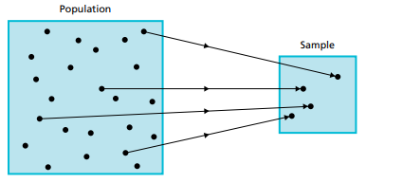
Fig1. the relation between population and sample
Basic Terms
Population or target population: The collection of all elements whose characteristics are being studied.
For example: total no. of students in a classroom, total no. of books in a library,………………..
Sample: A portion/fraction of the population of interest.
For example: ……………

Slide 12
Survey:
A survey is a research method used for collecting data from a predefined group of respondents to gain information and insights into various topics of interest
Census:
A survey that includes every member of the population is called a census.
Sample Survey:
A survey that includes only a portion of the population is called a sample survey.

Slide 13
Basic terms continued…..
Variable
- A variable is a characteristic under study that assumes different values for different elements.
- For example: Height of students, ……
- A variable is often denoted by letters x, y, or z
- The value of a variable for an element is called an observation or measurement.
- For example: ………………..

Slide 14
Data: collection of information/observations
Observation: The value of a variable for an element
or
the set of measurements collected for a particular element.
Data set: A data set is a collection of observations on one or more variables
Element/Member: An element or member of a sample or population is a specific subject or object (for example, a person, firm, item, state, or country) about which the information is collected.

Slide 15
Following data represents the annual income of youths entrepreneurs.
Name | Income (in NRs.)
Michael | 450000
Harry | 900000
Krishna | 700000
John | 670000
Mala | 400000
Kristina | 290000
Jasmine | 710000
Shyam | 500000
Andrew | 450000
Birat | 555000
Q1. What is the variable for this dataset?
Q2. How many observations are in the data set?
Q3. How many elements does this data set contain?

Slide 16
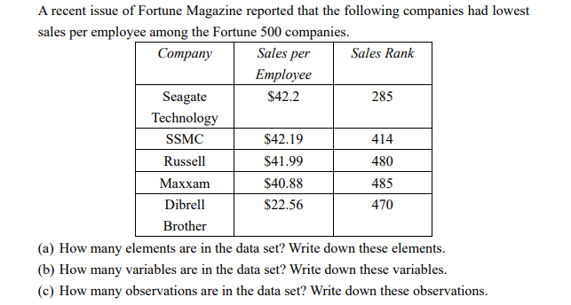
Exercise continued…

Slide 17
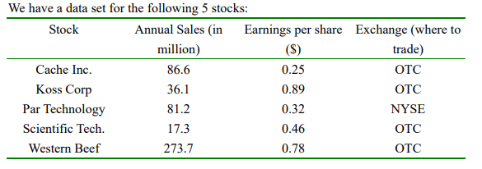
a. How many elements are in the data set? Write down these elements. b. How many variables in the data set? Write down the variables. c. How many observations are in the data set? Write down the observations.
Exercise continued…

Slide 18
Types of Variables
Some variables (such as the height of person, price of groceries) can be measured numerically, whereas others (such as occupation, hair color, income sources) cannot.
Variables are classified into two types:
Quantitative Variable
Qualitative Variable

Slide 19
Quantitative Variable
A variable that can be measured numerically is called a quantitative variable.
The data collected on a quantitative variable are called quantitative data.
Example: Age of student: 23, 24, 25, 15, 19, 18
Other examples:
Annual Gross sale
No. of accidents
Weight of a laptop
Distance between your house and college
Temperature
No. of gadgets owned

Slide 20
As you can see from the above examples that certain quantitative variable can assume may be countable or noncountable
Quantitative variables may be classified into two categories
Discrete Variable
Continuous Variable

Slide 21
Discrete Variable
Variable whose values are countable.
In other words, a discrete variable can assume only certain values with no intermediate values.
For example:
- No. of accidents
The no. of daily admissions in a general hospitals
The no. of people visit bank in on any day
The no. of students in a classroom
The no. of books in a library

Slide 22
B) Continuous Variable
A variable that can assume any numerical value over a certain interval or intervals
Example:
Price of book: USD105.6
Body temperature
Expenditure on food on any day
The time it takes to complete a certain task

Slide 23
Qualitative or Categorical Variable
A variable that cannot assume a numerical value but can be classified into two or more nonnumeric categories is called a qualitative or categorical variable.
The data collected on such a variable are called qualitative data.
Examples:
- Gender of a person
A person’s blood type
Occupation
Modes of transportation

Slide 24
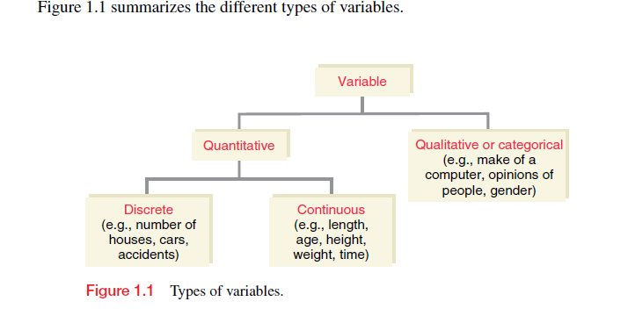

Slide 25
Population
In simple terms, population means the aggregate of all objects/units/elements/items related to the topic of the study
It can be of any size, and the number of elements or members or units in a population is known as Population size.
Population size denoted by letter “N”
Population may be finite or infinite

Slide 26
Finite population:
If the no. of units in the population is countable in a certain time.
For example: total no. of students in Pulchowk Campus
Total no. of employee in Ncell etc.
Infinite population:
If the no. of units in the population is not countable in a certain time.
For example: total no. of stars in the sky
Total no. of trees in the forest
Hypothetical population
Assumed population
Example:

Slide 27
Sample
A fraction (or a part) of a population selected in any manner from the population for the purpose of investigation.
The sample so selected should be such that it represent the population in all its characteristics
It is a subset of population and is always finite
It should be free from bias
The sample observations are used to make generalizations about the population.

Slide 28
Census
A study conducted all units of the population
In another word, complete enumeration of all elements of the population
Example: Population census survey, Industrial census survey
Merits:
Suitable for small population
Suitable for rare events
If information about all units of population is required
Demerits:
- Expensive method, requires large no. of resources, longer time to complete study, for infinite population this method is impossible

Slide 29
Sampling
When study of whole population is not possible due to factors like time, cost, manpower, resources and destructive nature of study, we take small representative portion of population. Small representative part selected from the population for the study is called sample
The process of selecting sample from a population is called sampling
Merits of sample survey
Less expensive, less time, needs smaller no. of resources, only method for large population
Demerits of sample survey
not suitable if information about all units of population required
Not suitable for rare events
Not appropriate for historical data

Slide 30
Parameter and Statistic
Various statistical measures in Statistics such as mean, mode, median, standard deviation, variation, correlation coefficient etc. can be computed for both population and sample data
Any statistical measure computed from population data is called parameter.
Any statistical measure computed from sample data is called statistic.

Slide 31
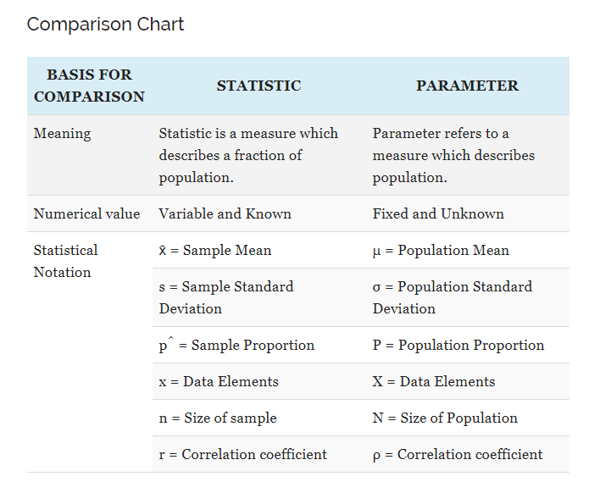
Statistic Vs Parameter

Slide 32
Types of sampling
Random or Probability sampling
Non- random or Non- probability sampling

Slide 33
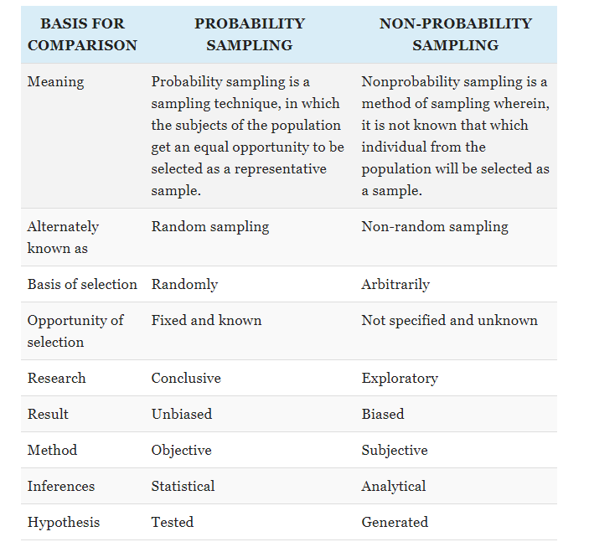
Probability Sampling Vs Non-Probability Sampling

Slide 34
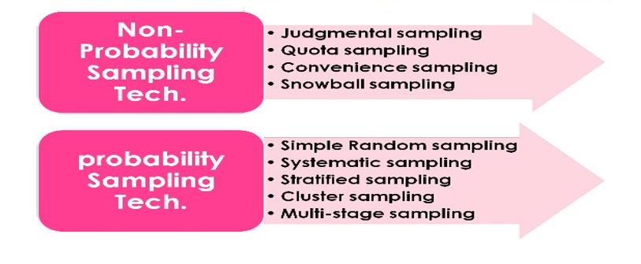
Types of sampling

Slide 35
Errors in Statistics
The errors involved in collection, processing and analysis of data in a survey may be classified as
Sampling error
Non sampling error

Slide 36
Sampling error:
The difference between the value of sample statistic and the value of corresponding population parameter
Sampling error = statistic – parameter
example
Sampling error= sample mean- population mean
A sampling error is the error which is made in selecting samples that are not representative of population.
It arises due to the fact that only a part of the population has been used to estimate population parameter and draw inferences about the population.
Such sampling errors are absent in a complete enumeration.
Following are some of the reason for the sampling error.
Faulty selection of a sample
Some of the sampling error occurs by the use of defective sampling technique for the selection of a sample.
2. Substitution
If difficulties arise in enumerating a particular sampling unit included in random sample, the investigators usually substitute a convenient member of the population. This is obviously leads to sampling errors.
3. Improper choice of statistic to estimate population parameter
Sometimes the biased estimator may create sampling error while estimating population parameter. Increase in sample size usually results in the decrease in sampling error.

Slide 37
b. Non-sampling error
It is occurred in sample as well as census survey
Non sampling error is likely to increase with increase in sample size while sampling errors decreases with increase in sample size
Non sampling errors arises from following factors
Error due to non response from respondents or unwillingness of providing correct data
Error in data processing (coding, data entry, tabulation etc.)
Faulty definition of population and sampling unit
Misunderstanding of collected information and Misinterpretation of results
Improper method of data collection

Slide 38
Sampling Distribution
Sampling distribution may be defined as the probability distribution of a given statistic based on a random sample.
Sampling distribution is very importance in statistics because they provide a major simplification on the way to statistical inference.
The sampling distribution serves two purposes:
They allows us to answer probability question about the samples statistic
They provide the necessary theory for the making statistical inference is valid.
Hence, the distribution of all possible values that can be assumed by some statistic, computed from samples of the size randomly drawn from the same population is called sampling distribution of that statistic.
The sampling distribution generally depends on the assumption of the underlying distribution of the population, the statistic being considered, the sampling procedure employed and the sample size used.

Slide 39
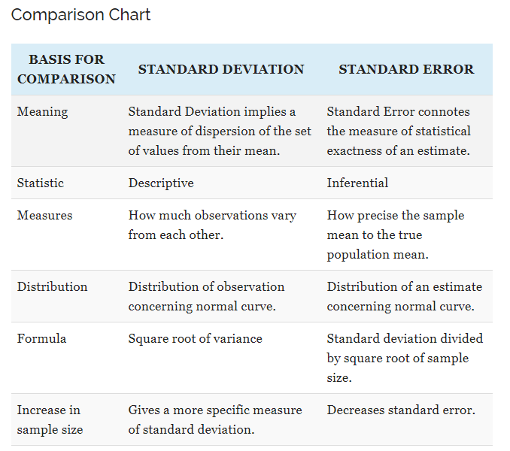
Standard Deviation Vs Standard Error

Slide 40
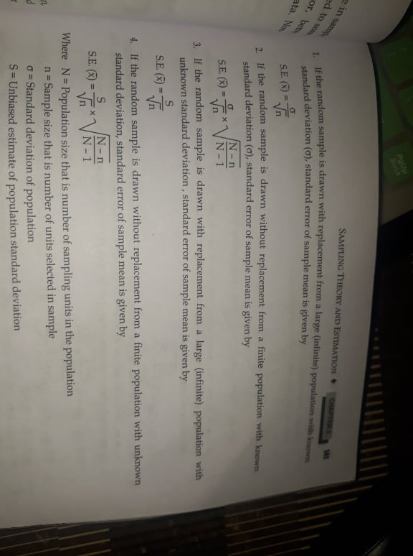
Standard error of sample mean
The standard deviation of the sampling distribution of the sample means is called standard error of the sample mean.

Slide 41
Numerical Problems
Q1. A sample of size 36 is drawn from the population consisting of 196 units. If the population sd is 7. Find the standard error of sample mean when the sample is drawn a) without replacement b) with replacement
Q2. A population of size 50 is sampled without replacement. The sd of the population is 0.75. We require the standard error of the mean to be no more than 0.25. what is the minimum sample size?

Slide 42
Q3. The mean wage for all 5000 employees who work at a large company is $27.50 and the standard deviation is $3.70. Let be the mean wage per hour for a random sample of certain employees selected from this company. Find the mean and standard deviation of for a sample size of (a) 30 (b) 70 (c) 200

Slide 43
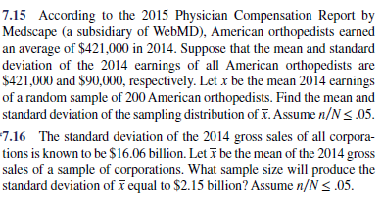

Slide 44
Numerical Problems
Q3. The population consists of a number 2, 4, 6, 8 and 10. a) enumerate all possible samples of the size 2 which can be drawn from the population without replacement b) calculate mean and variance of the population c) show that the mean of the sampling distribution of the sample mean is equal to the population mean. D) Prove that sample mean is unbiased estimate of population mean E) calculate the variance of the sampling distribution of sample mean. F) standard error of mean.
Q4. The population consists of a number 1, 3, 5, 7 and 9. a) enumerate all possible samples of the size 2 which can be drawn from the population without replacement b) calculate mean and variance of the population c) show that the mean of the sampling distribution of the sample mean is equal to the population mean. D) Prove that sample mean is unbiased estimate of population mean E) calculate the variance of the sampling distribution of sample mean. F) standard error of mean.

Slide 45
Q5. The population consists of four numbers 2, 5, 6, and 7.
a) enumerate all possible samples of the size 2 which can be drawn from the population with replacement b) calculate mean and variance of the population c) show that the mean of the sampling distribution of the sample mean is equal to the population mean. D) Prove that sample mean is unbiased estimate of population mean E) calculate the variance of the sampling distribution of sample mean. F) standard error of the sample mean.

Slide 46
Q6. The population consists of four numbers 3, 5, 6 and 8.
a) enumerate all possible samples of the size 2 which can be drawn from the population with replacement b) calculate mean and variance of the population c) show that the mean of the sampling distribution of the sample mean is equal to the population mean. D) Prove that sample mean is unbiased estimate of population mean E) calculate the variance of the sampling distribution of sample mean. F) standard error of the sample mean.

Slide 47
Population proportion and Sample proportion
The concept of proportion is same as the concept of relative frequency distribution
The relative frequency of a category or class gives the proportion of the sample or population
Population Proportion:
The ratio of the number of elements in the population having specific characteristics to the total no. of elements in the population
It is denoted by capital alphabet P
Population proportion (P) = X/N

Slide 48
Sample proportion
The ratio of the number of elements in the sample having specific characteristics to the total no. of elements in the sample
It is denoted by small alphabet p
Sample proportion (p) = x/n
x= no of elements in the sample that possesses a specific characteristic
n= total no. of elements in the sample

Slide 49
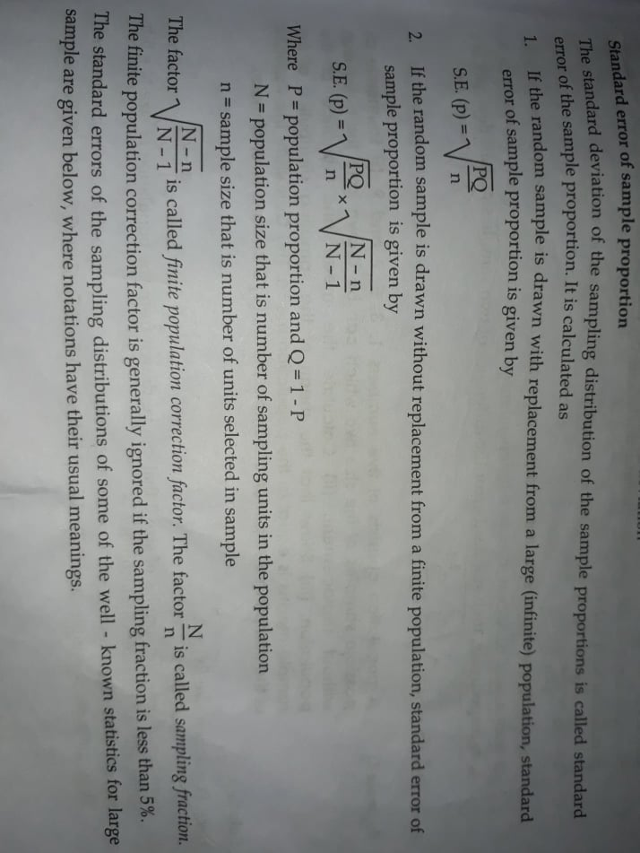

Slide 50
Exercise
Q1. A random sample of 600 optical mouses of XYZ brand was taken from a large consignment and 65 of them are found to be bad during inspection. Find the standard error of the population of bad optical mouses.
Q2. Suppose 60% of seniors who get Covid vaccine remain healthy, independent from one person to the next. A senior apartment complex has 200 residents and they all get Covid vaccine. What proportion will remain healthy?

